Slide 1
Element Fusion
By Pixel Code
Jamie Collinge – Artist
Michael Sweeney - Programmer

Slide 2
Initial Project Proposal
Candy Crush-Style Match 3
Elements Art Theme
Android phone/tablet + (iPhone)
Time/Blitz Mode + (Puzzle Mode)
Power Ups Shop
Notes:
Michael

Slide 3
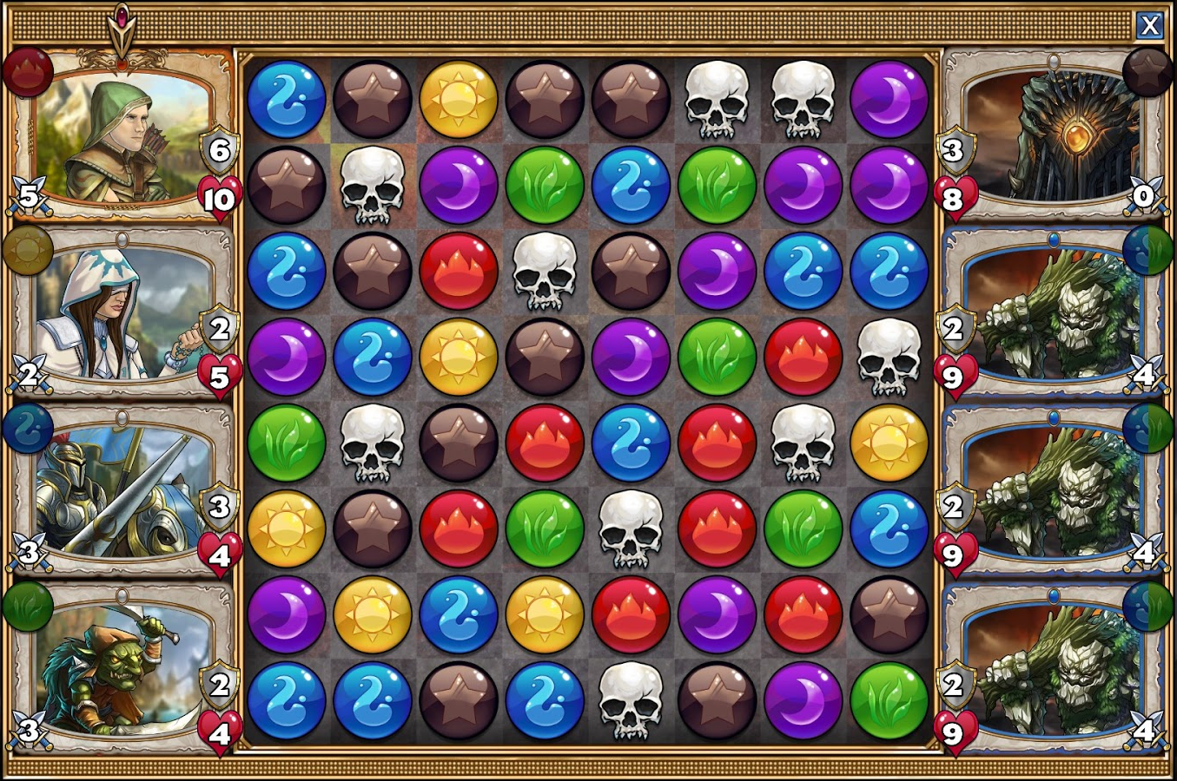
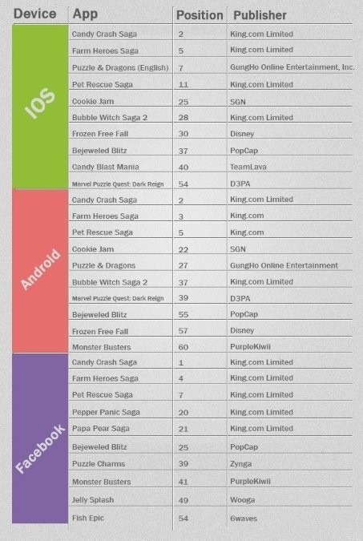
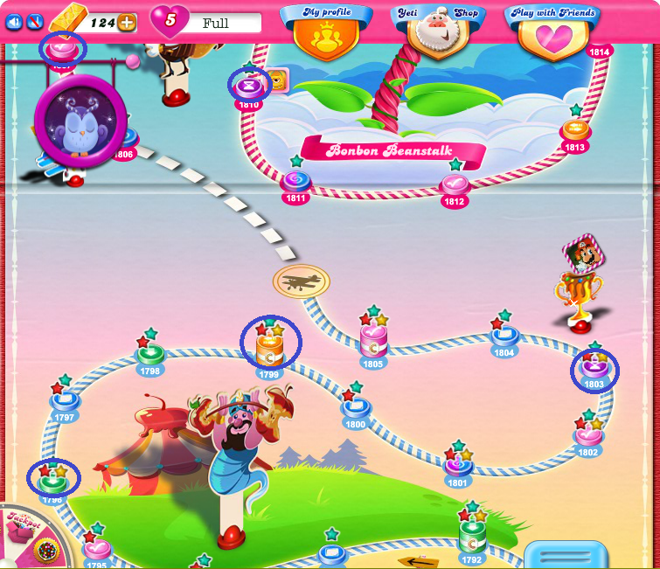
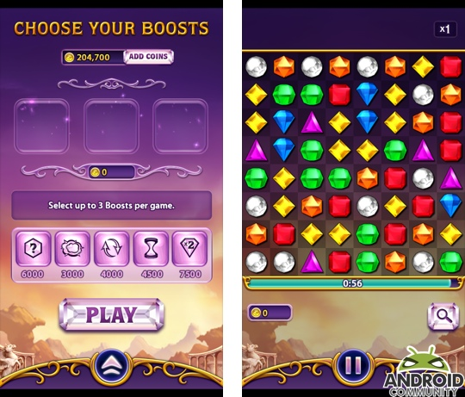
Research
Gems of War
Bejewelled Blitz
Candy Crush Saga
Notes:
Michael
https://www.choicestgames.com/2014/11/gems-of-war-review.html
https://androidcommunity.com/bejeweled-blitz-launches-for-android-20130503/
https://care.king.com/en/candy-crush-saga/all-hexagon-levels-on-candy-crush-saga-are-removedhttps://care.king.com/data/king_qna_en/media/forum/image/05/74/63/69712/4616/19daab74552b8e0f/wherearehexagonlevel..png

Slide 4
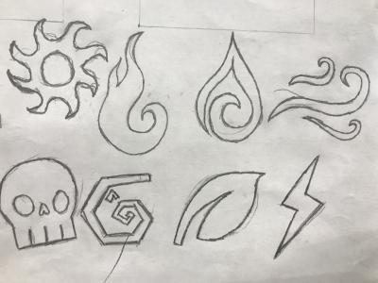














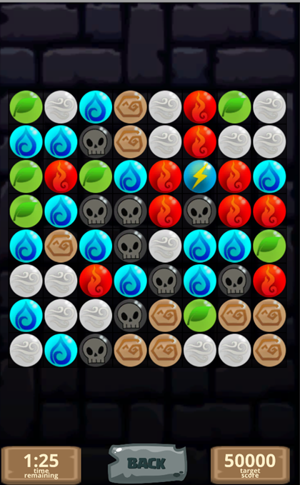
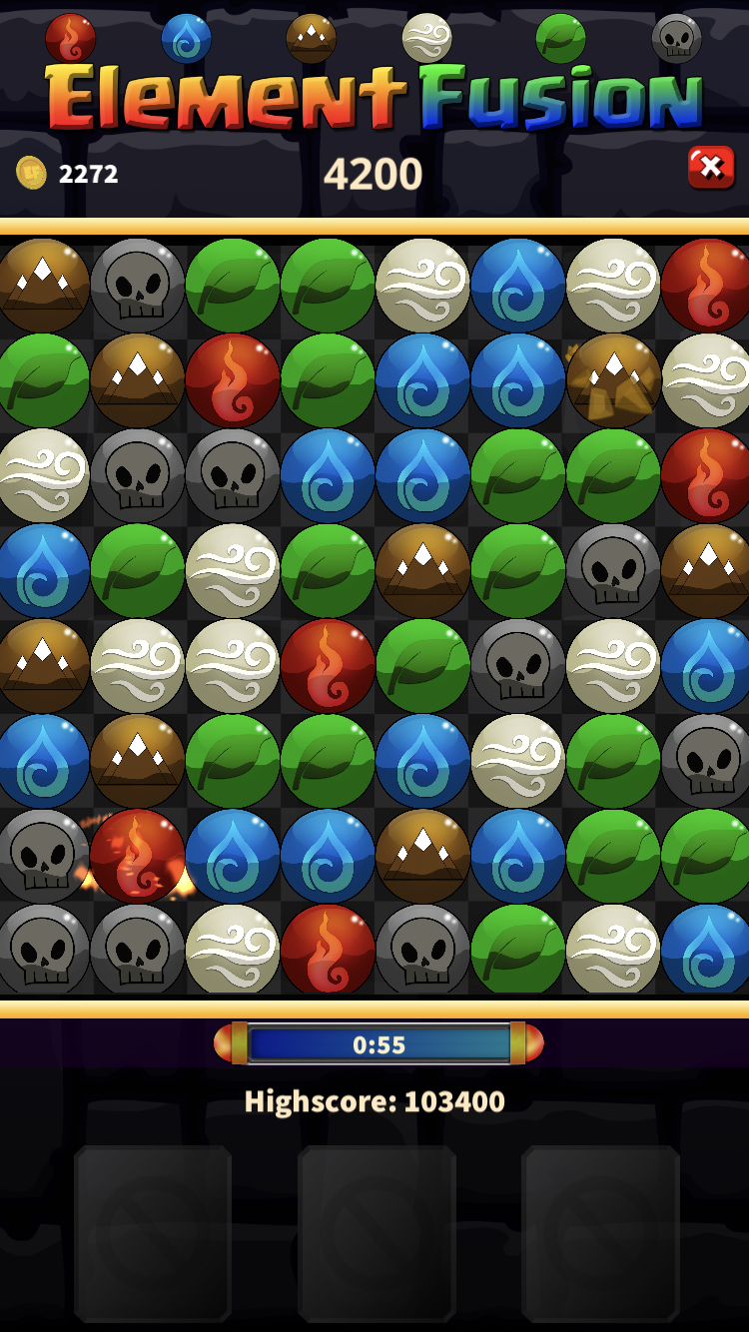
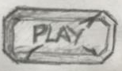




Art Development
Notes:
Jamie

Slide 5
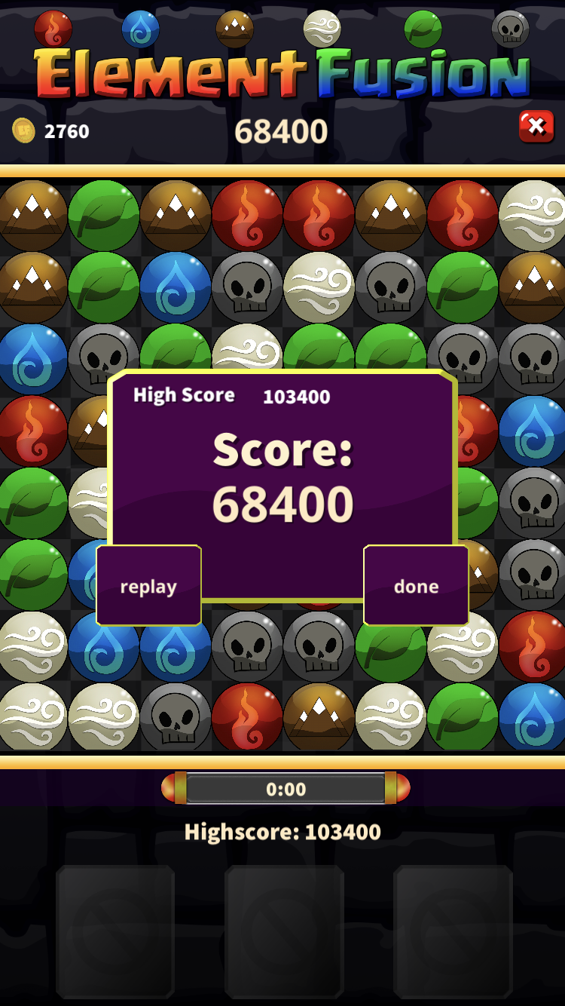
Features - Blitz
Notes:
Jamie

Slide 6
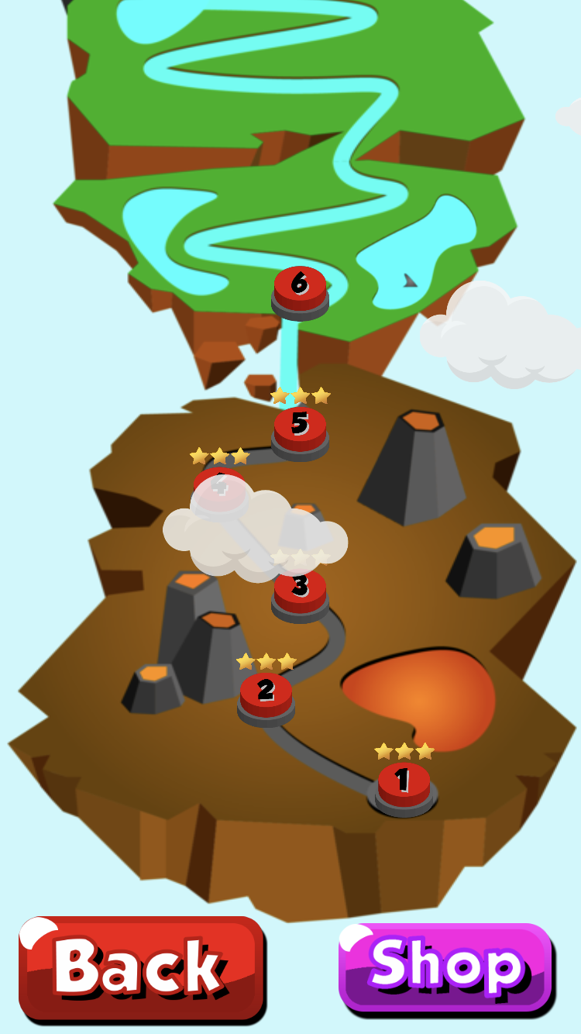
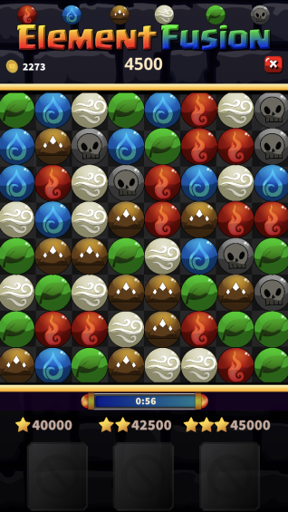
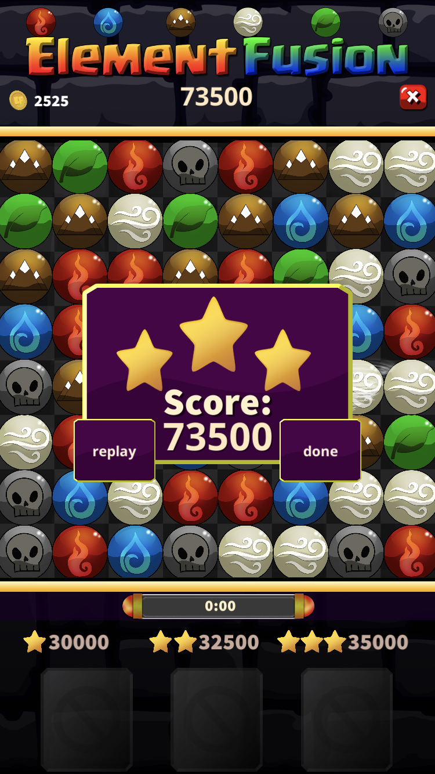
Features - Story
Notes:
Jamie

Slide 7
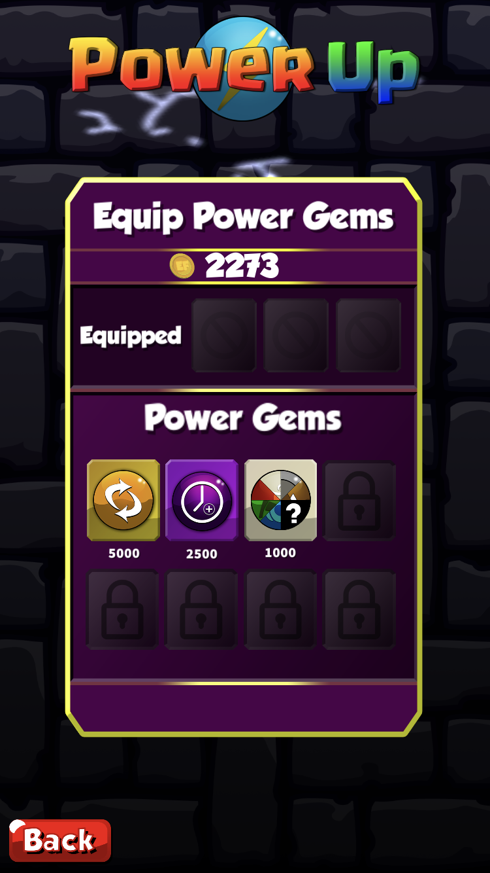
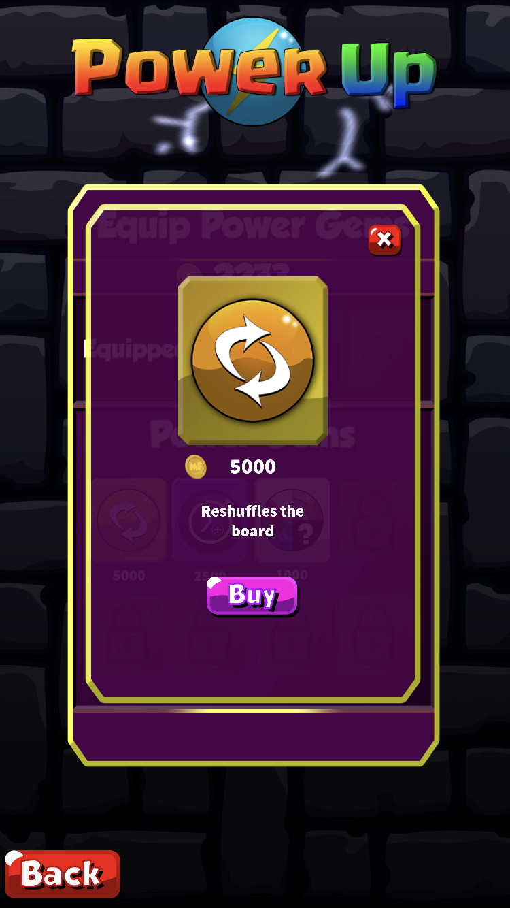
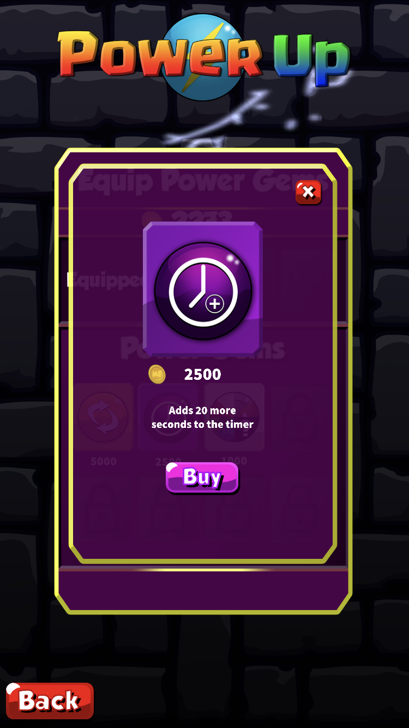
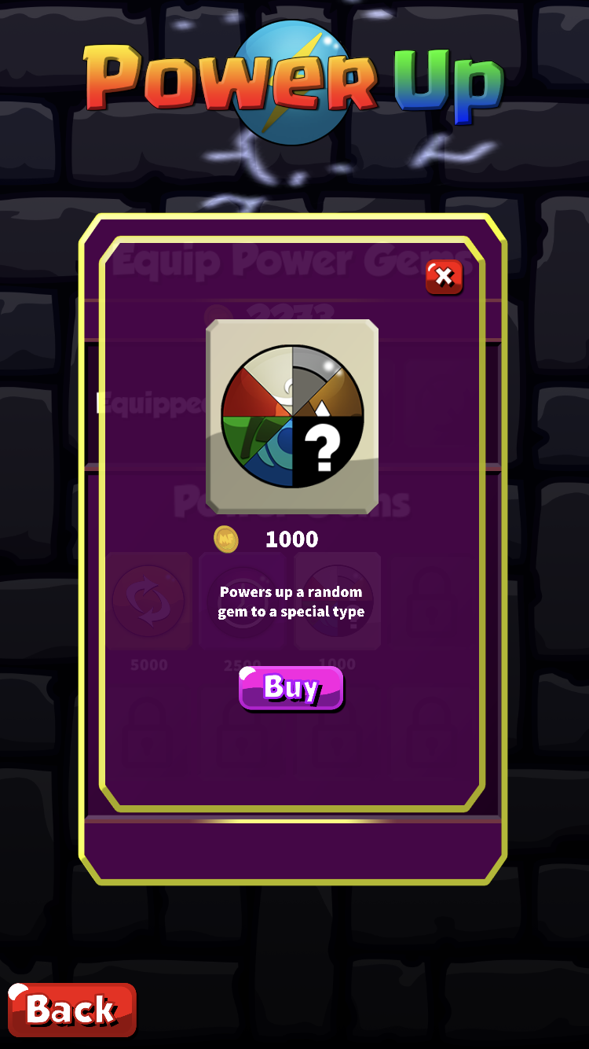
Features - Shop
Notes:
Jamie

Slide 8
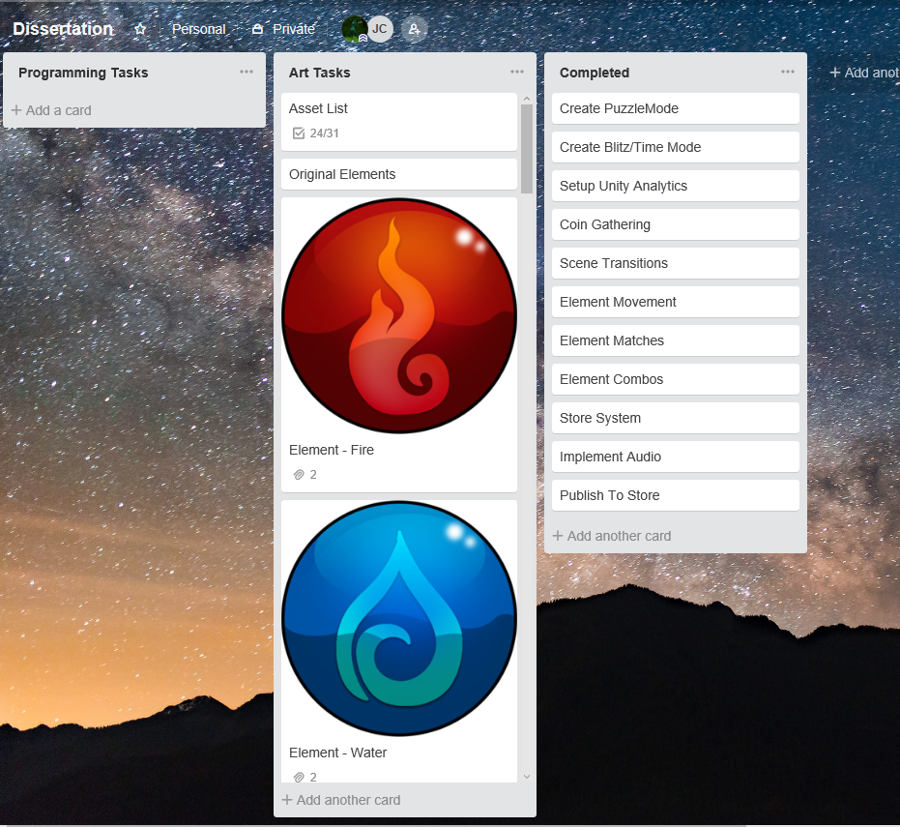
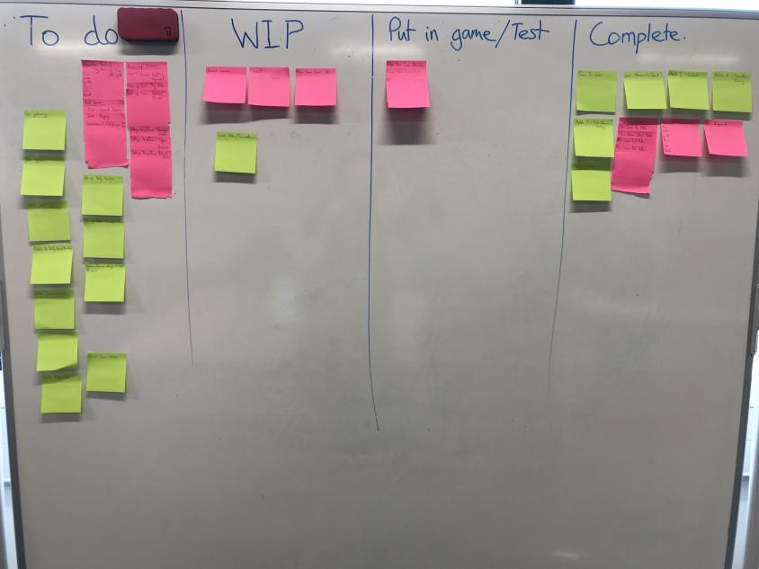
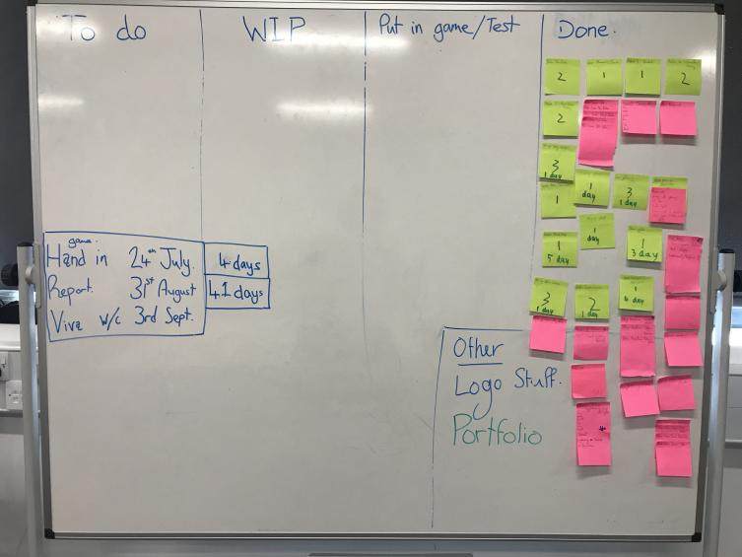


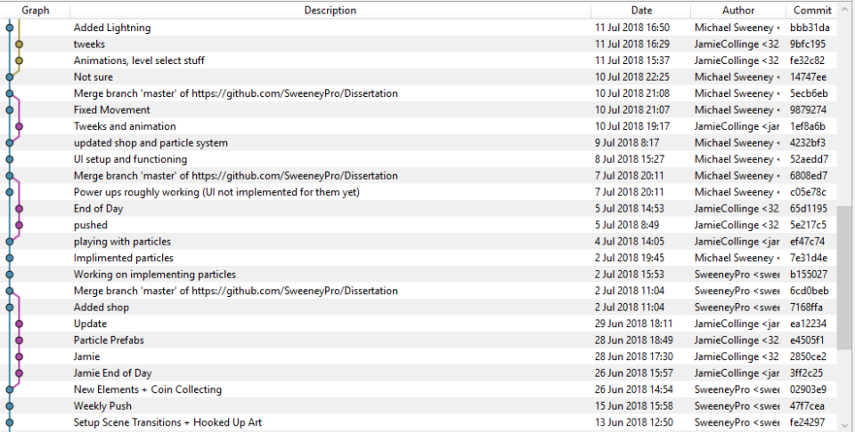
Project Management and Source Control
KanBan
Trello
GitHub Repo
GitHub Client
SourceTree
Notes:
Jamie

Slide 9
Analytics and Testing
Mixed Story Progression
Players utilising the shop
Scramble most popular
Store Usage
Notes:
Michael

Slide 10
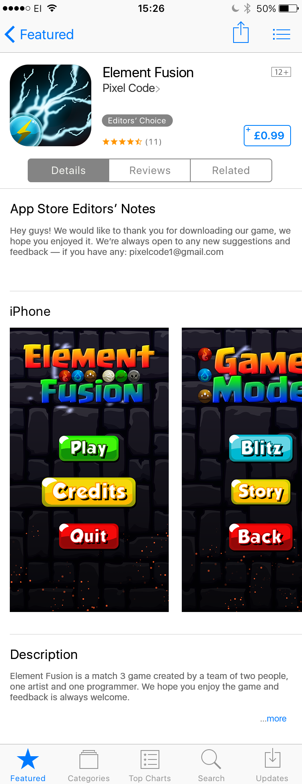
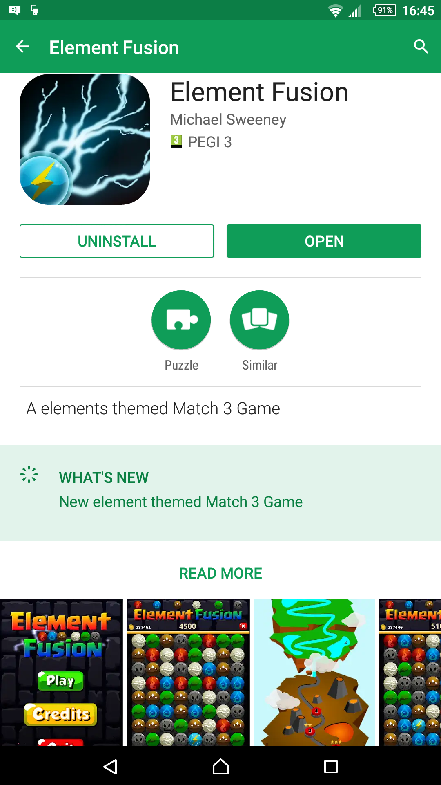
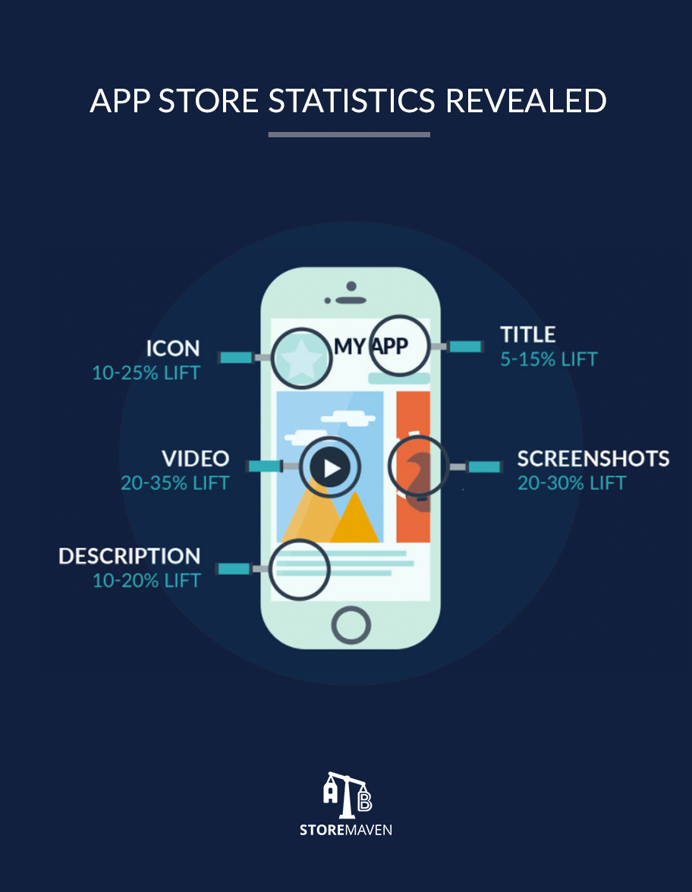
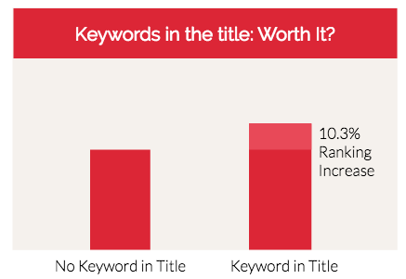
Marketing
Android Store
iPhone Store
Announcement on social media
App Store Optimisation
Notes:
Michael
https://moz.com/blog/app-store-optimization-checklist
https://neilpatel.com/blog/everything-need-know-app-store-optimization/

Slide 11
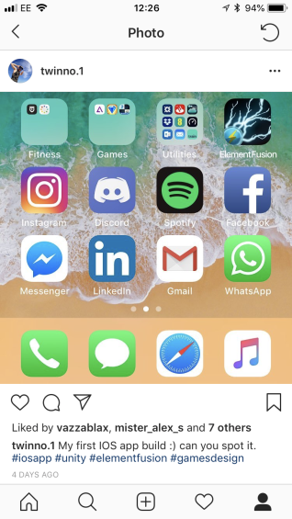
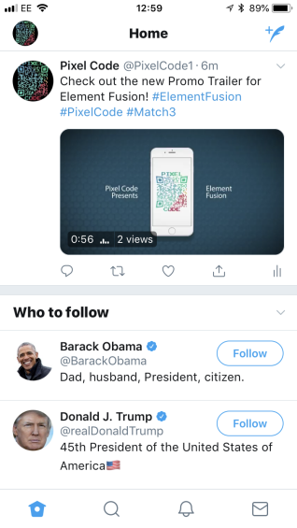
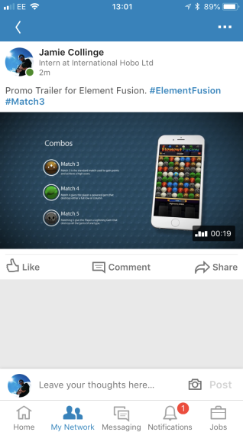
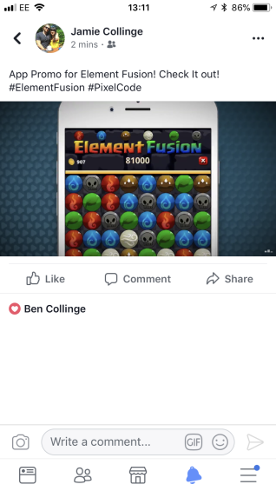




Social Media
Notes:
Jamie?

Slide 12
References
https://moz.com/blog/app-store-optimization-checklist
https://neilpatel.com/blog/everything-need-know-app-store-optimization/
https://png.icons8.com/color/1600/twitter-squared.png
https://upload.wikimedia.org/wikipedia/commons/f/fb/Facebook_icon_2013.svg
https://instagram-brand.com/wp-content/uploads/2016/11/app-icon2.png
https://github.com/
https://www.sourcetreeapp.com/
https://www.choicestgames.com/2014/11/gems-of-war-review.html
https://androidcommunity.com/bejeweled-blitz-launches-for-android-20130503/
https://care.king.com/en/candy-crush-saga/all-hexagon-levels-on-candy-crush-saga-are-removedhttps://care.king.com/data/king_qna_en/media/forum/image/05/74/63/69712/4616/19daab74552b8e0f/wherearehexagonlevel..png

Slide 13
Any Questions?

